Slide 1
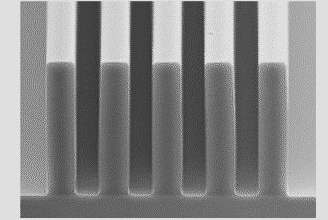
Lecture 2
Chemical Engineering for Micro/Nano Fabrication

Slide 2
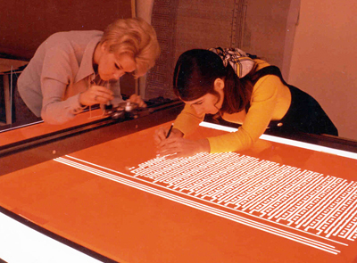
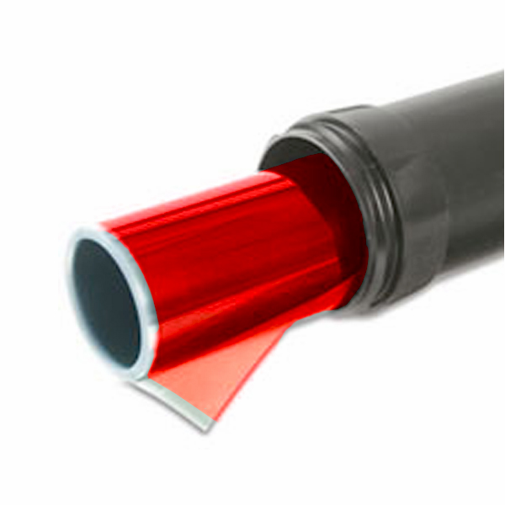
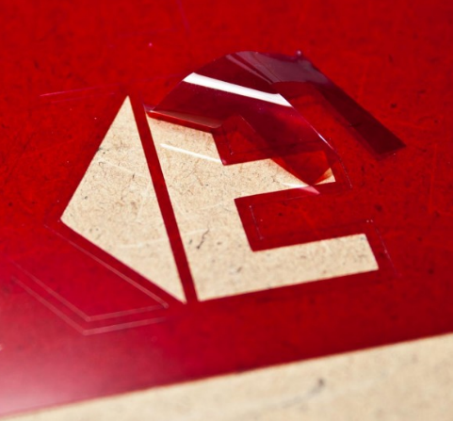
Rubylith Mask Making

Slide 3
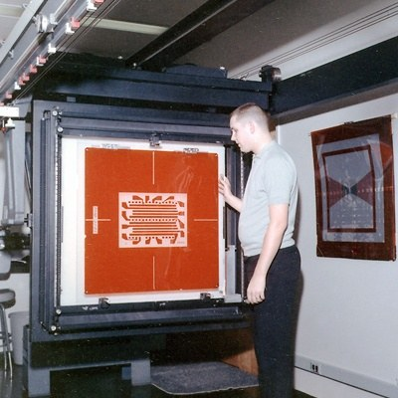
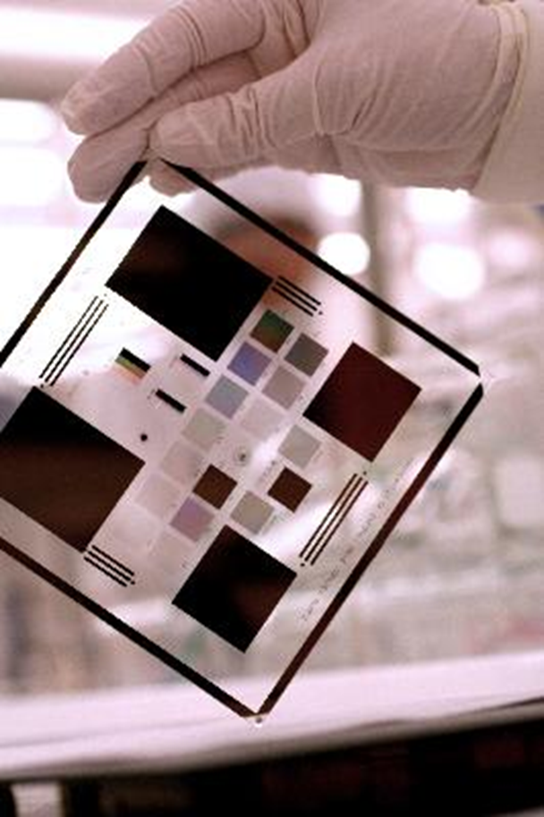
Rubylith Mask Making

Slide 4
Masks Making
Earliest Masks were “emulsion” Masks made by photographic processing
Emulsion Masks were made on glass
This design failed due to fragile character of the gelatin emulsion
The emulsion Mask was replaced with Chromium on glass
This fundamental design has persisted to this day
We will discuss the fabrication of modern masks in some detail later in the course.

Slide 5
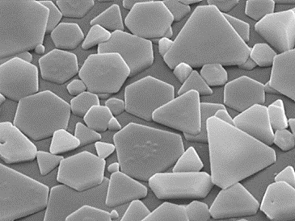
Photographic emulsion of AgCl
Expose
Develop - monomethyl-p-aminophenol hemisulfate, base
Stop – Acetic Acid
Fix – Sodium Thiosulfate

Slide 6
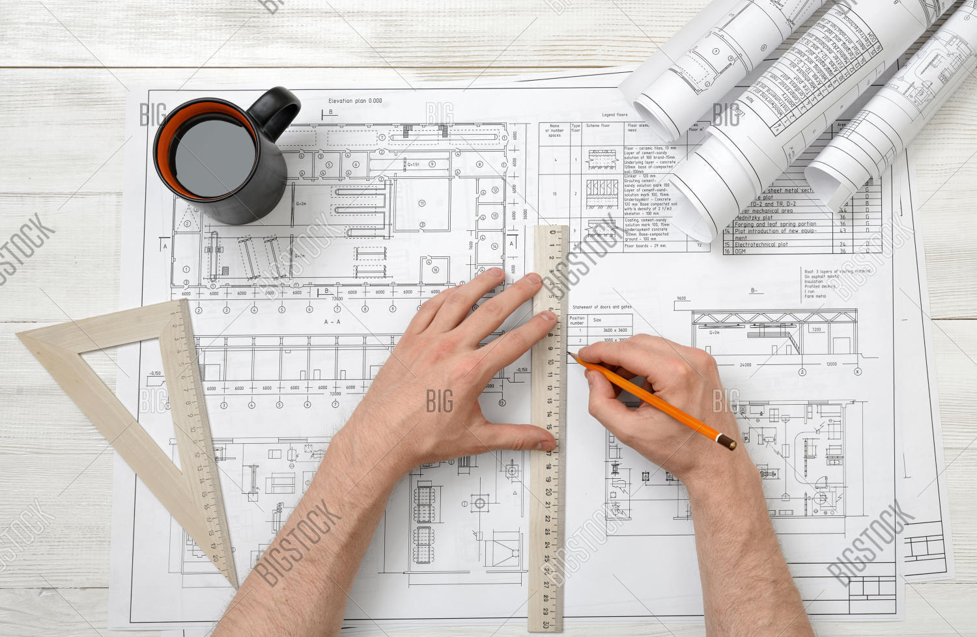
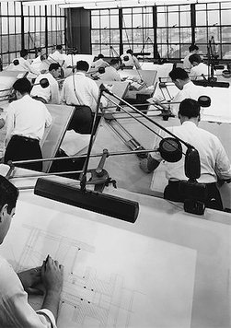
Engineering Drafting

Slide 7
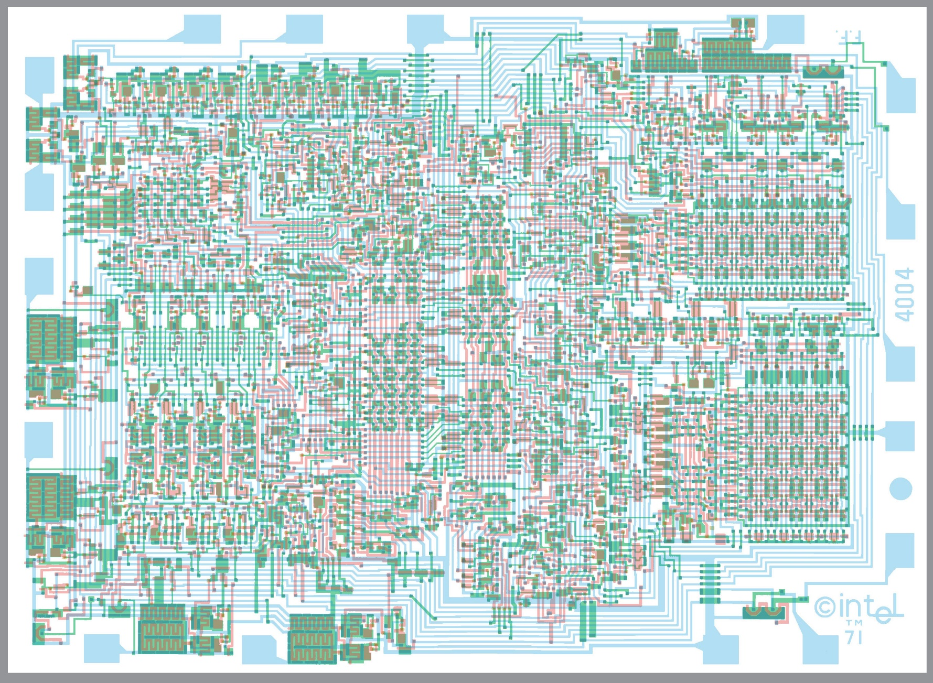
CAD Drawn Mask

Slide 8
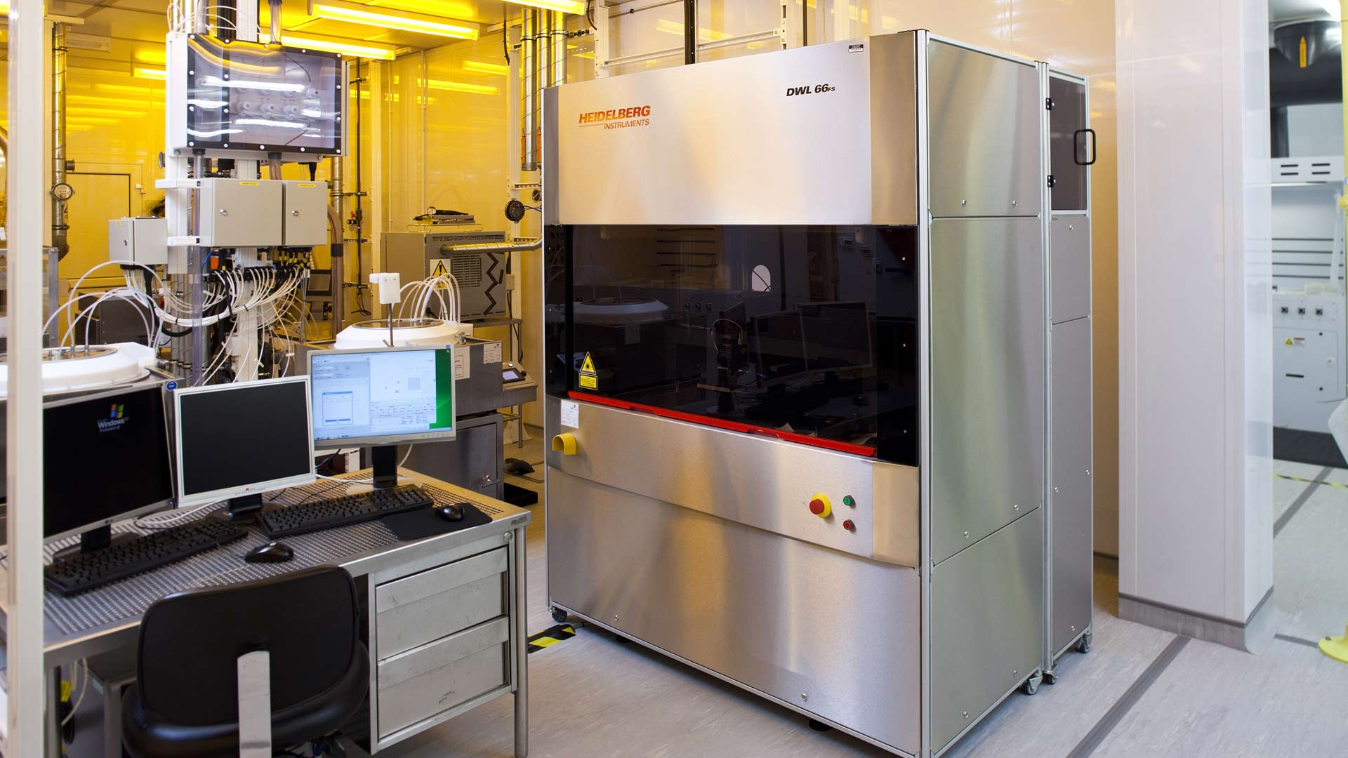
Laser Mask Writers

Slide 9
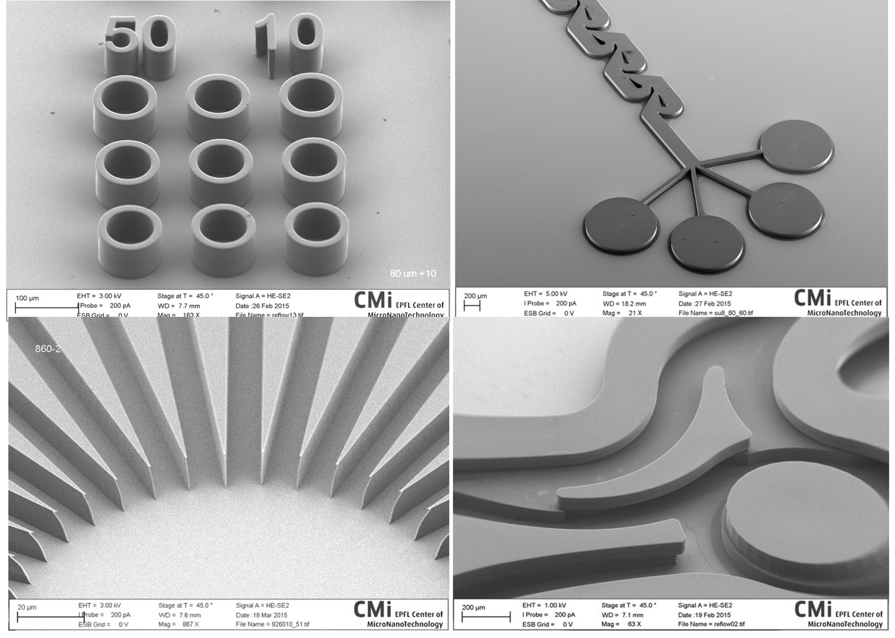
Laser Mask Writers

Slide 10
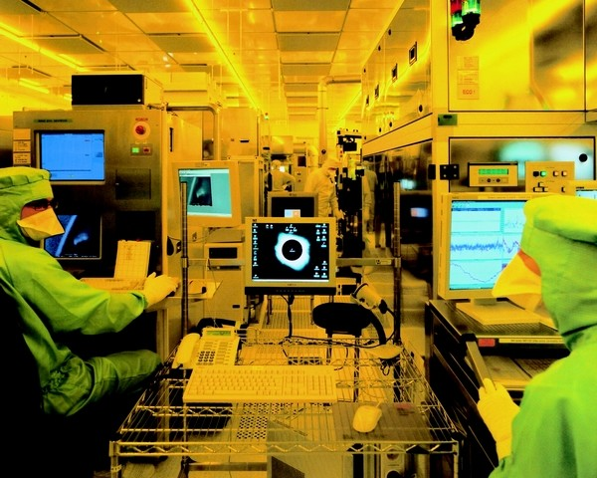
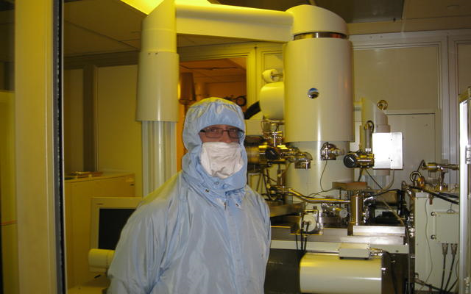
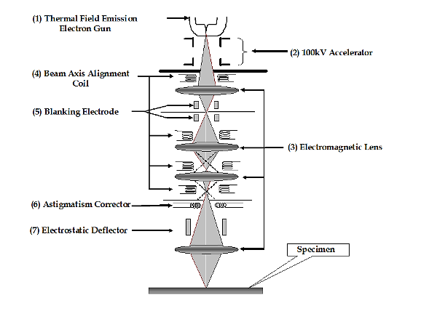
Electron Beam Lithography

Slide 11
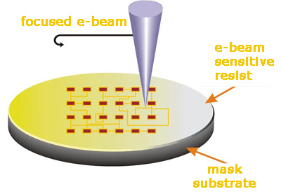
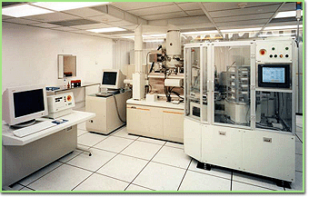
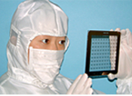
Electron Beam Lithography for Masks
Converts Computer patterns into Masks
High resolution but slow and very expensive!

Slide 12
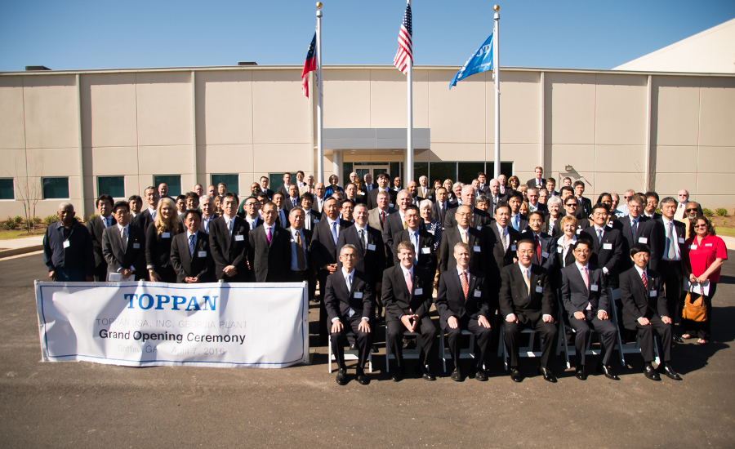
Toppan Photomask Round Rock, TX

Slide 13
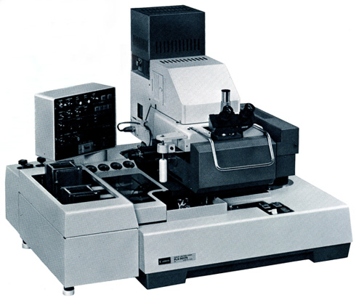
Contact Mask Aligner

Slide 14
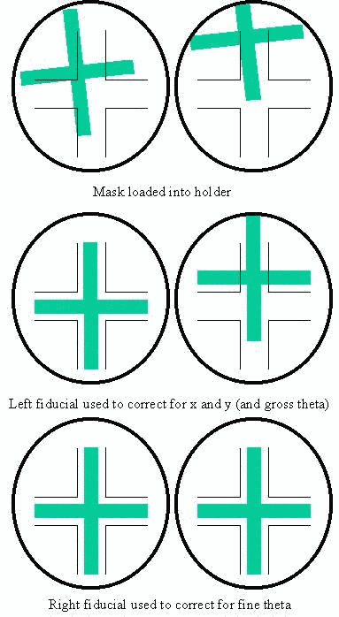
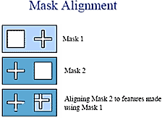
Contact Mask Aligner

Slide 15
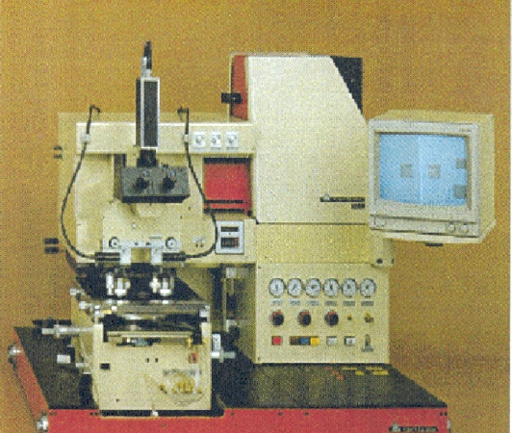
We Started With Contact Printing
Element of
the Condenser
Mirror
Heat Removing Filter
Point
Source
Shutter
Spherical
Mirror
Element of
the Condenser
Mask
Resist
X-movement
Wafer
Swiveling
movement
Z-movement
Notes:
The light source is usually a point source, typically a gas discharge arc lamp such as Xenon (Xe), or Mercury (Hg) arc lamps chosen for high efficiency in the desired spectral region.
The photomask is pressed against the wafer with a pressure of 0.05 – 0.3Atm.
Advantage: The mask contains all the patterns for all of the chips on the wafer. So every pattern is exposed in a single exposure.
How good is the technique?

Slide 16
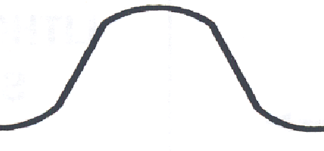
The Fundamental Issue – Information Transfer
MASK
WAFER
Light Source
LESS THAN 100% INFORMATION
100%
INFORMATION
OPTICAL
LITHOGRAPHY
SYSTEM
Notes:
Resolution relates to how fine a feature, such as a line or trench, can be reproduced in the resist from the aerial image. It is related to the optical contrast of the resist, which is determined by the resist chemistry and by processing.
Recall that I did not draw the aerial image in the previous slide as a square wave, which would correspond to the IDEAL light intensity distribution at the wafer plane . Rather I showed the intensity distribution at the wafer plane as a GAUSSIAN-type distribution, which gives rise to a corresponding Gaussian distribution of absorbed energy density in the resist.
Clearly the fidelity of the aerial image has been degraded by the exposure tool. If the square wave pattern associated with the mask represents 100% information then the transmitted aerial image clearly represents less than 100% information.
The problem is that the line edge of the aerial image of the feature is difficult to determine. The design of the resist can compensate to some degree for this loss in image fidelity, but clearly the closer the aerial image is to the ideal light intensity pattern square wave, i.e., the higher the optical contrast, the easier it should be in principle to realize the desired critical dimensions in the resist.
Hence it is important to understand what factors control the quality of the aerial image and how they can be manipulated to get the most out of the optical lithography system.

Slide 17
MASK
Glass
LIGHT
I_{max}
Chrome
I_{min}
I_{max}
I_{min}
I_{max}
I_{max} – I_{min}
I_{max} + I_{min}
MODULATION =
Notes:
Modulation is also known as OPTICAL CONTRAST

Slide 18
Modulation in Contact Printing
RESIST
MASK
WAFER
ILLUMINATION
I_{max} – I_{min}
I_{max} + I_{min}
MODULATION =
1
Modulation of the mask is ?
Modulation of the image is ?
~1
The image is almost perfect!
Notes:
Problem is that the mechanical contact between the mask and wafer causes defects on the mask and wafer with consequent negative impact on productivity.

Slide 19
But….let’s look at some Resists

Slide 20
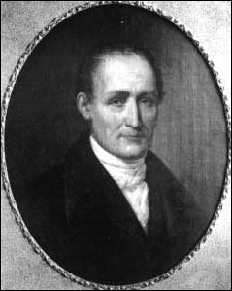
“It” All Started Here
NICÉPHORE
NIÉPCE
1765-1883

Slide 21
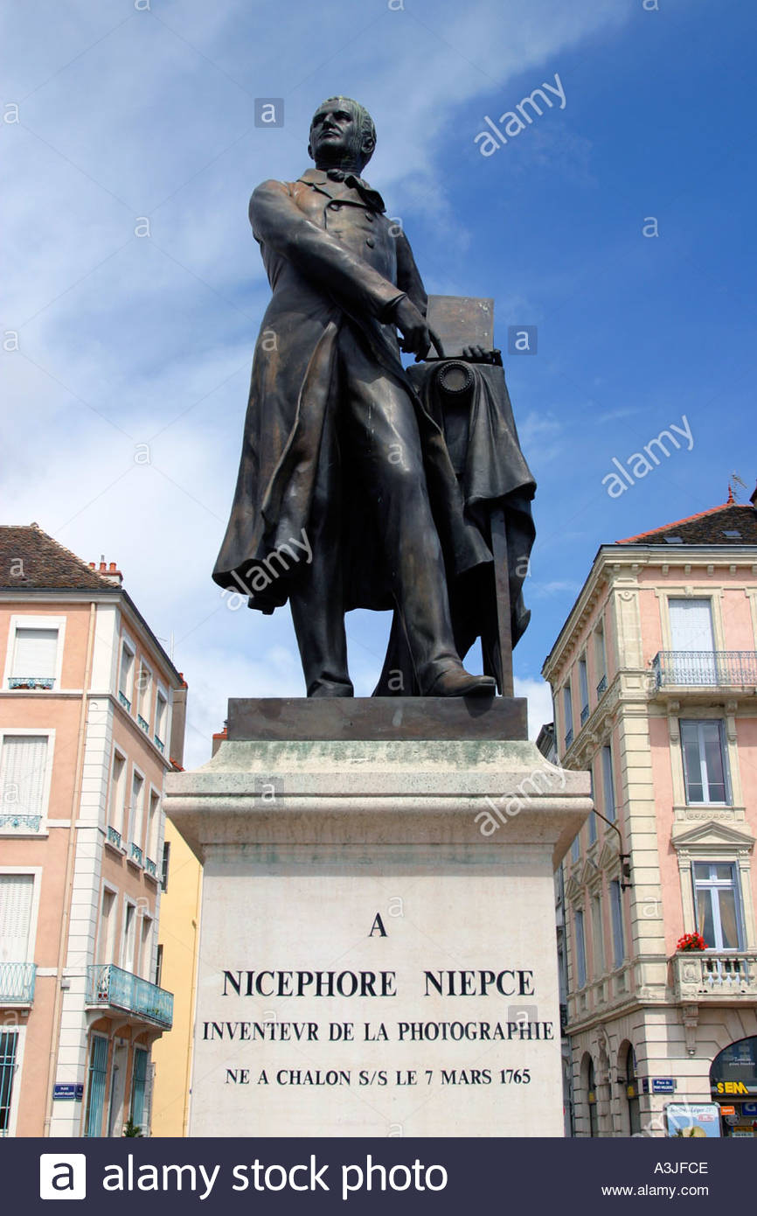
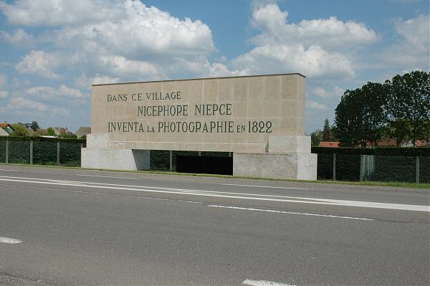
Chalone sur Soane

Slide 22
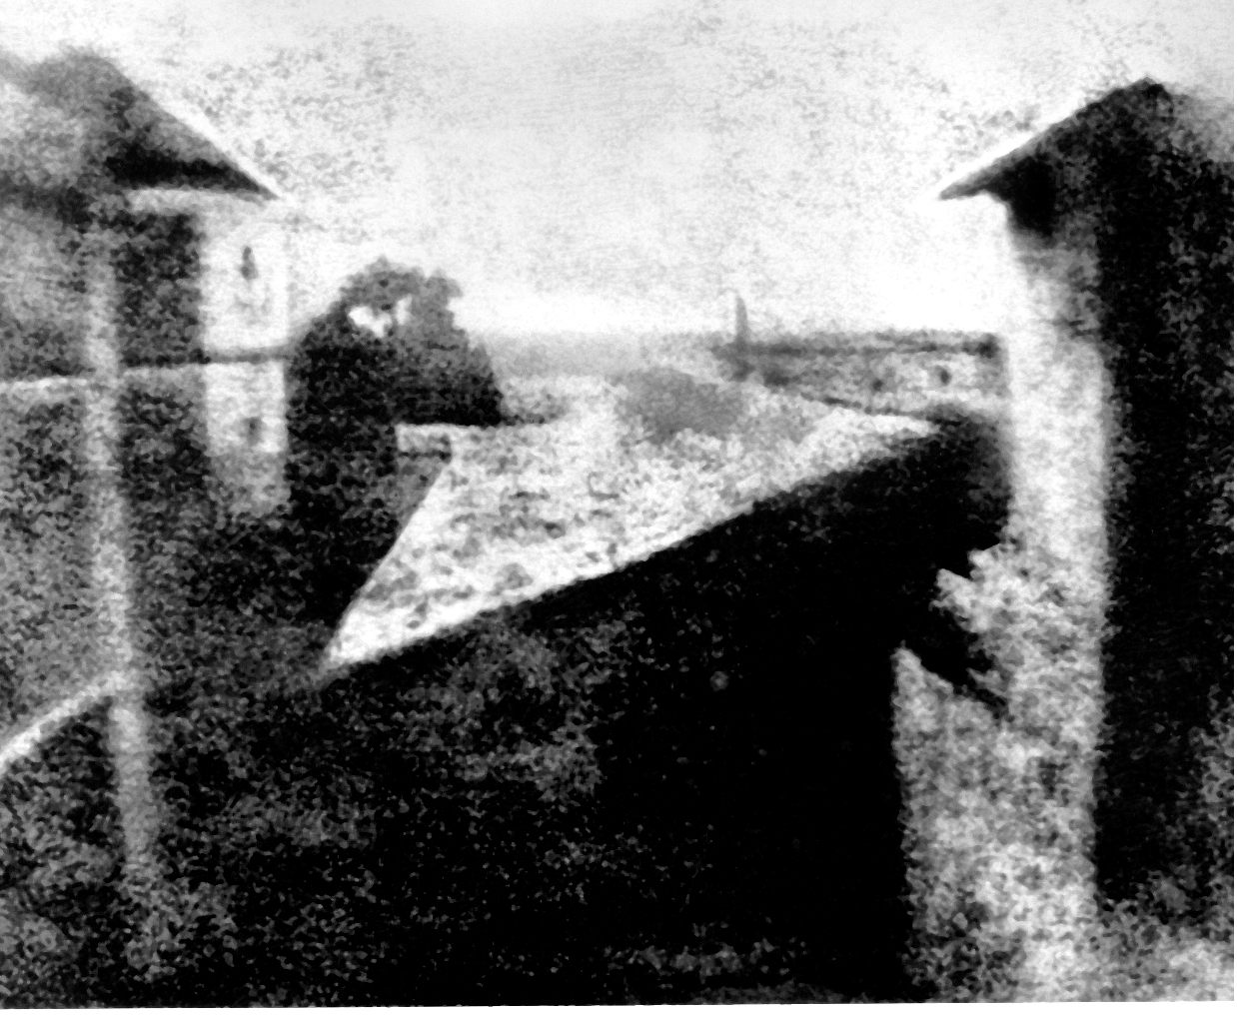
A Historical Perspective
Printed with Bitumen of Judea 1826
“Point de vue du Gras” by Nicephore Niepce

Slide 23
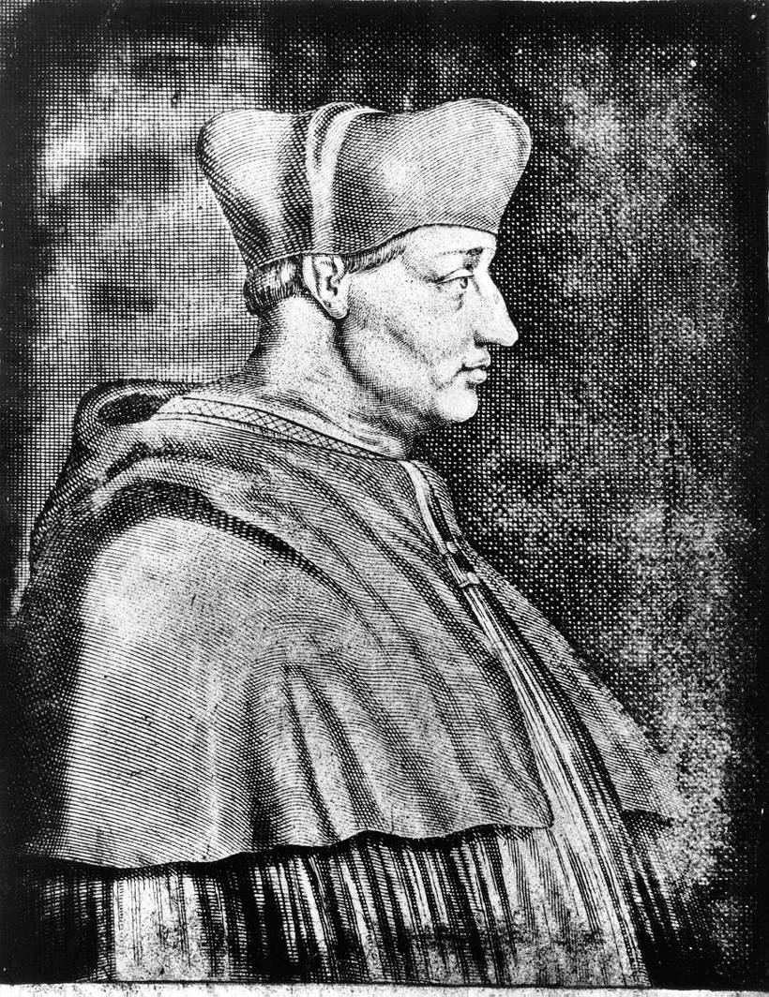
Contact Printing in Bitumen of Judea
A Contact Photogravure
of Cardinal d’ Amboise
by Niepce (1826)

Slide 24
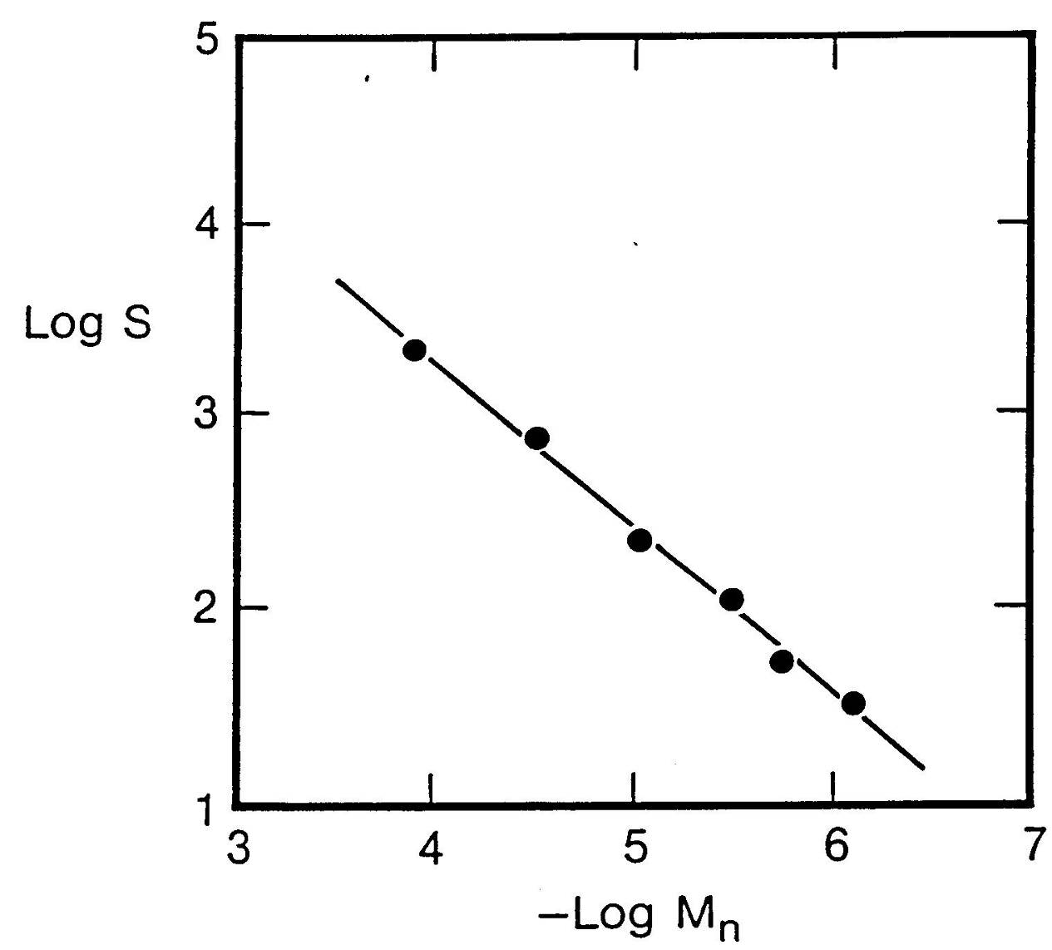
PMMA in MIBK

Slide 25
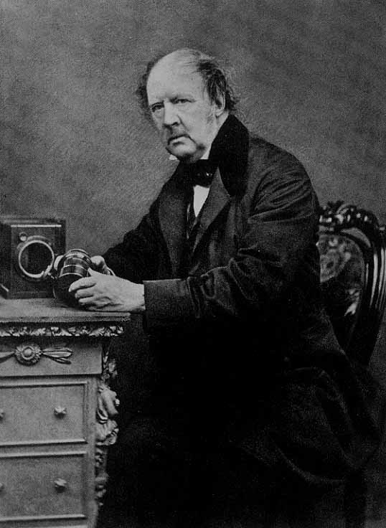
Dicromated Gelatin
Protein + K₂Cr₂O₇
High Sensitivity
Poor Shelf Life
William Henry Fox Talbot
Photographed in 1864

Slide 26
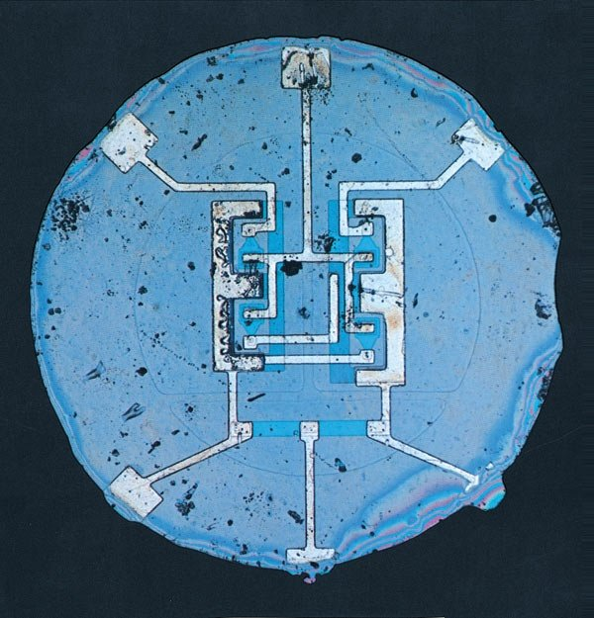
Early Planar Integrated Circuit
Shockley Noyce Ca. 1960

Slide 27
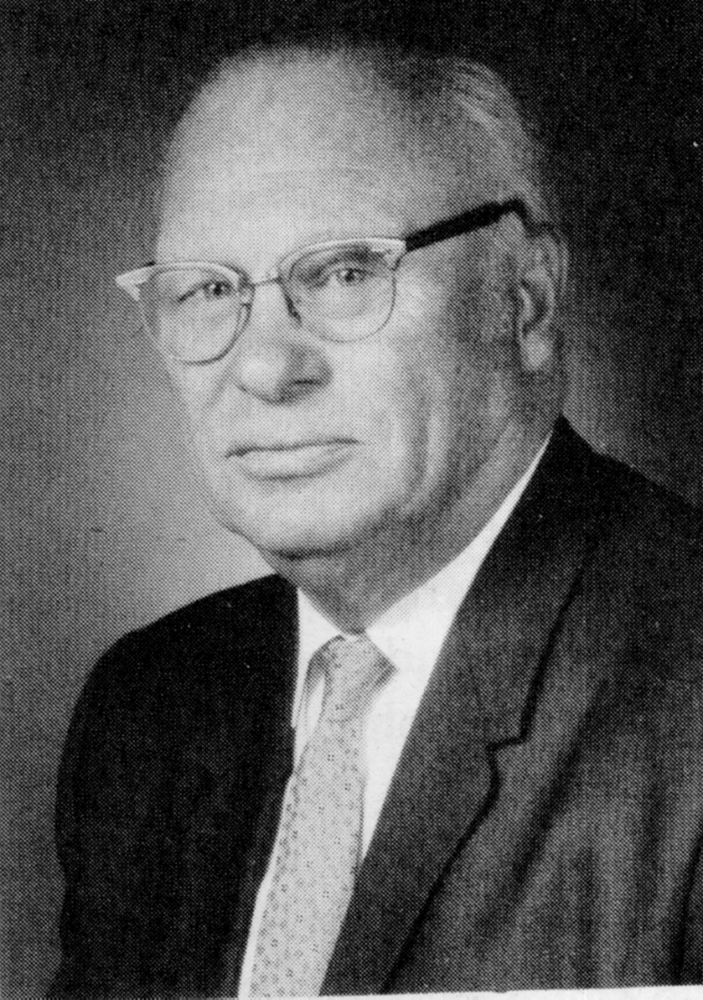
The First Synthetic Photopolymer
Louis Minsk
Eastman Kodak
Poly(vinyl cinnamate)
Adhesion Problems

Slide 28
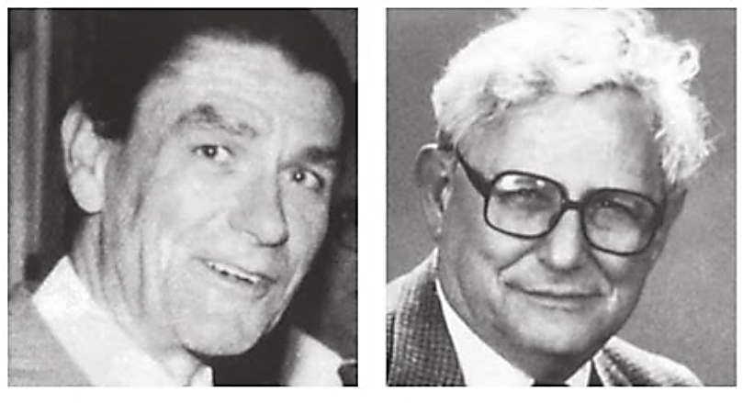
Co-inventors of Kodak’s KTFR
Martin Hapher Hans Wagner

Slide 29
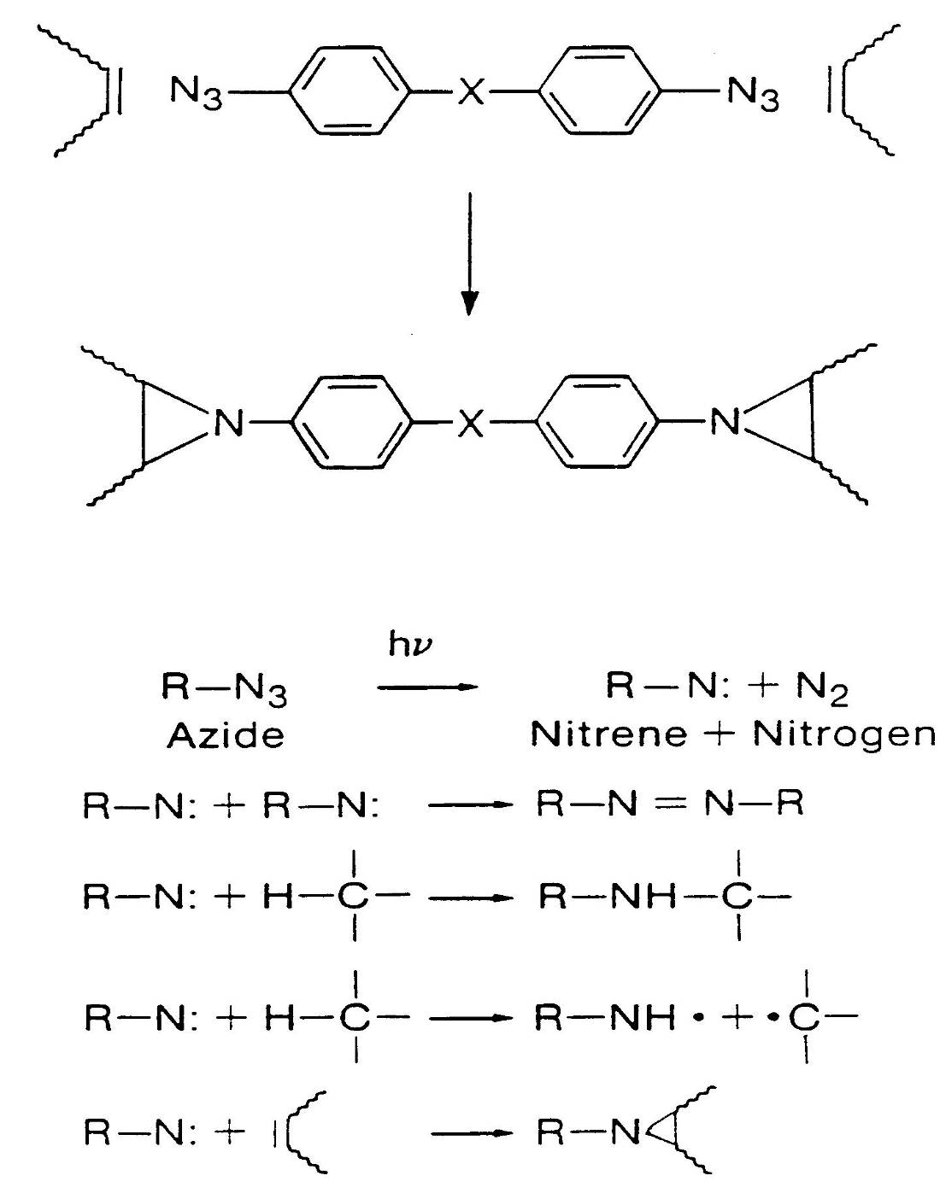

Slide 30
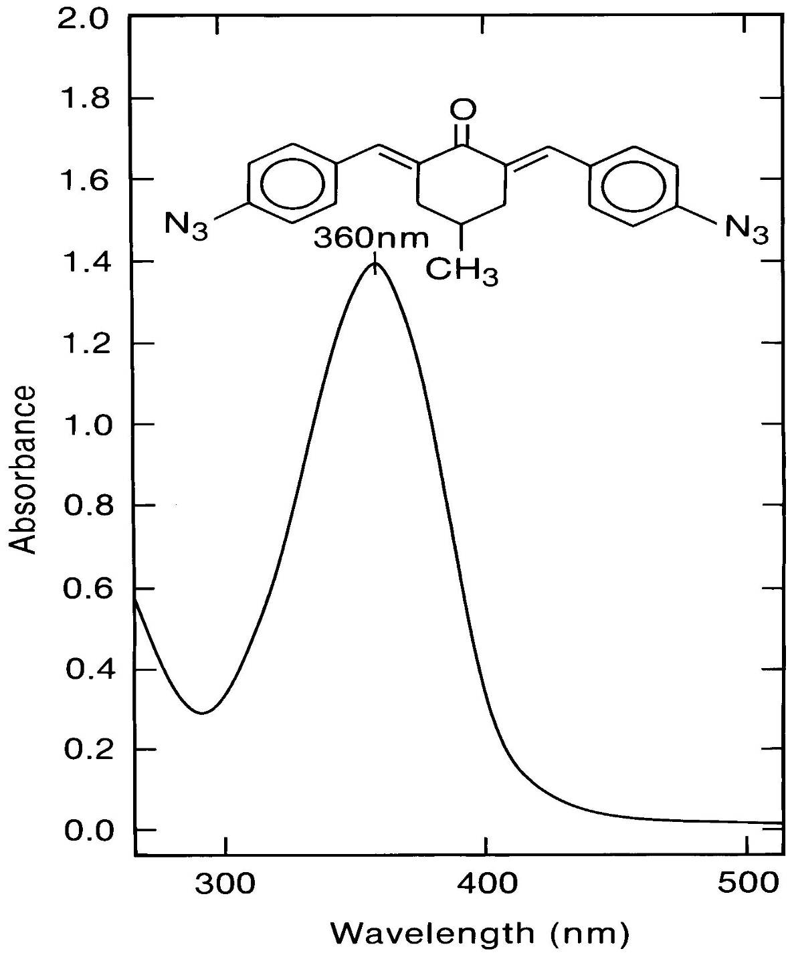

Slide 31
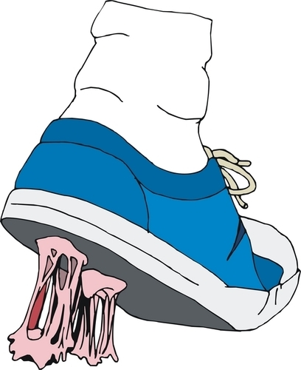
This stuff is GLUE!!

Slide 32
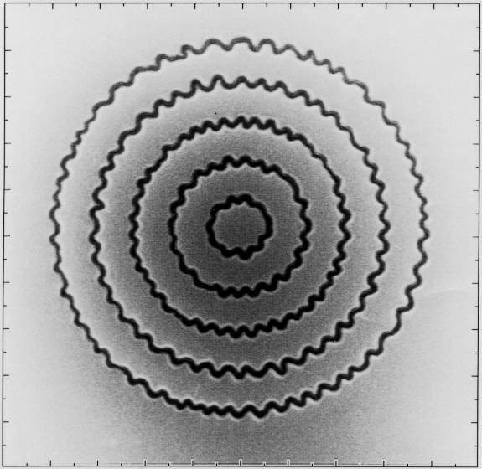
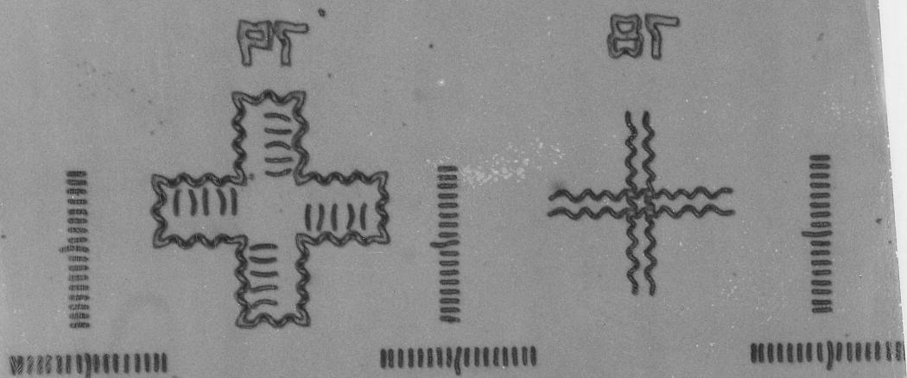
It cannot sustain high aspect ration images.
Swelling, Snakes, Ugh!!

